Slide 1

PREDICTIVE ANALYTICS · MACHINE LEARNING MINI PROJECT
Predicting Customer Churn
DONE BY :
FLOYD OMBURO - 190095
GRIFFIN MUKUNGU - 190236

Slide 2
PREDICTIVE ANALYTICS · MACHINE LEARNING
Predicting Customer Churn
A comparison of KNN, Decision Tree, SVM & Neural Network classifiers
for identifying customers likely to leave
7,043
21
26.5%
4
Customers
Raw Features
Churn Rate
Models Compared

Slide 3

THE PROBLEM
Losing customers quietly costs the most
Churn is when a customer ends their relationship with a business — cancels a subscription, switches provider, or simply stops paying.
It's a silent leak: customers rarely announce they're leaving before they do.
Winning back a lost customer is far harder — and costlier — than keeping one who's already on the fence.
If a business can flag at-risk customers early, it can intervene: a call, a discount, a fix — before it's too late.
IN OUR DATASET
26.5%
of customers in the Telco dataset churned — roughly 1 in 4. Left unaddressed, that's a quarter of the customer base walking out the door.
That's exactly what this project sets out to do: predict churn before it happens.
2

Slide 4


THE DATA
Telco Customer Churn Dataset
A real-world dataset of telecom customers, capturing who they are, what services they use, and whether they eventually left.
7,043
20
2
Customer records
Predictive features
Outcome classes: Stay / Churn
FEATURE GROUPS
Demographics
Account info
Services
Charges
gender, senior citizen, partner, dependents
tenure, contract type, payment method, billing
phone, internet, streaming, security add-ons
monthly charges, total charges
3

Slide 5





OUR APPROACH
From raw data to a working prediction
1
2
3
4
5
→
→
→
→
Clean & Encode
Split & Scale
Train Models
Evaluate
Interpret
Handle missing values, convert text to numbers
Separate train/test sets, scale features for KNN
Tune KNN, Tree, SVM & ANN via cross-validation
Compare accuracy, precision, recall, F1, ROC AUC
Identify which factors drive churn most
4

Slide 6

STEP 1
Cleaning & Preparing the Data
Dropped customerID
It's just a label — no predictive value.
SHAPE BEFORE → AFTER
7,043 × 21
raw columns
↓
7,043 × 31
encoded, model-ready columns
Fixed TotalCharges
11 blank entries (new customers) coerced to numeric and filled.
Encoded the target
Churn mapped from Yes/No to 1/0 for the model to read.
Encoded categoricals
Binary columns (Partner, gender...) mapped to 0/1; multi-category columns (Contract, InternetService...) one-hot encoded.
5

Slide 7


STEP 2
Train/Test Split & Feature Scaling
We held out 20% of customers as a test set the models never see during training — and stratified the split so both sets keep the same ~26.5% churn rate.
Train — 5,634 customers (80%)
Test
1,409 (20%)
KNN, SVM & ANN need scaling
Trees don't need it
KNN measures straight-line distance, SVM fits margins, and the neural net trains by gradient descent. Without scaling, MonthlyCharges (0-120) would drown out a 0/1 column — so we standardize every feature to the same scale first.
A Decision Tree just asks yes/no threshold questions, like “is tenure < 6 months?” That comparison works the same whether values are scaled or not — so we feed it the raw, unscaled features.
6

Slide 8
STEP 3
Two Classic Algorithms: KNN & Tree
K-Nearest Neighbors
Decision Tree
“You are like the company you keep.”
“A flowchart of yes/no questions.”
Plots every customer in feature space
To predict a new customer, finds their K closest neighbors
Takes a majority vote among those neighbors
If most neighbors churned, it predicts churn
Splits customers into branches by threshold
e.g. “Is tenure < 6 months?” then “Fiber optic internet?”
Each leaf ends in a Stay / Churn prediction
Produces rules a manager can read and explain
Best setting found: k = 29 neighbors
Best setting found: max depth = 8
7

Slide 9
STEP 3B
Two More Algorithms: SVM & ANN
Support Vector Machine
Artificial Neural Network
“Draw the widest street between the two classes.”
“A web of tiny decisions, layered and weighted.”
Finds the hyperplane that best separates Stay vs Churn
Maximizes the margin between the closest points of each class
A linear kernel worked best on this scaled, high-dimensional data
A customer's side of that boundary is its predicted class
Neurons combine weighted inputs through hidden layers
One hidden layer of 50 neurons was enough for this data
Learns non-linear patterns a straight line would miss
Powerful, but harder for a manager to interpret directly
Best setting found: C = 0.1, linear kernel
Best setting found: hidden layer (50,), alpha=0.001
7b

Slide 10
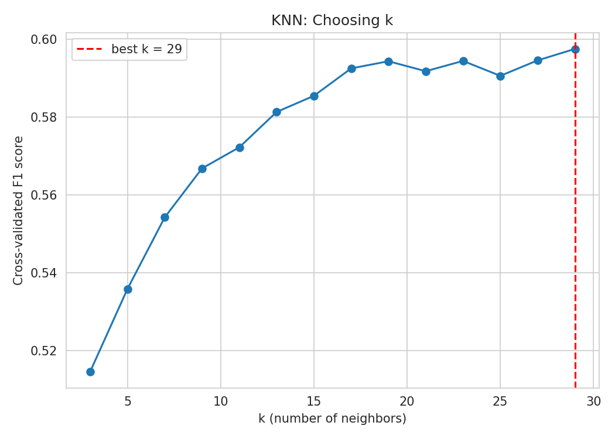
STEP 4A
Choosing K with Cross-Validation
We tested every odd k from 3 to 29, scoring each with 2-fold cross-validation on the training set, and kept the k with the best F1 score.
Too small a k (e.g. 1-3): overly sensitive to noise, overfits
Too large a k: too smooth, misses real patterns
k = 29 gave the best balance, with cross-validated F1 ≈ 0.60
Selected: k = 29 neighbors
The default scikit-learn value (k=5) would have overfit — tuning mattered.
8

Slide 11
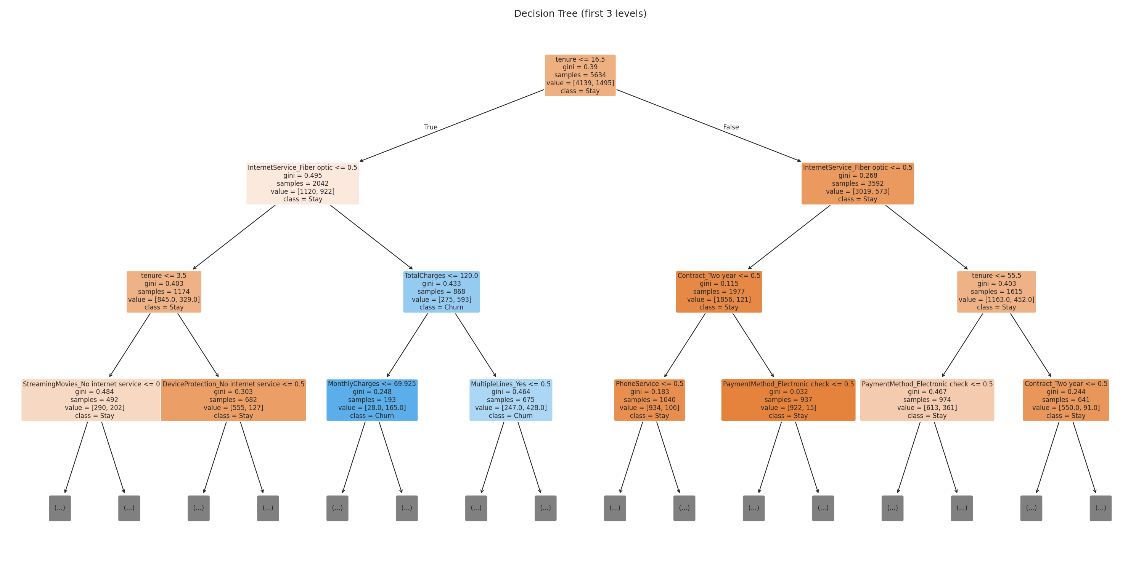
STEP 4B
Growing the Decision Tree
A tree with no depth limit will memorize the training data perfectly — and generalize poorly. We tuned max depth and minimum leaf size the same way, via cross-validation.
First 3 levels shown — the full tree goes 8 levels deep, split on 20 samples minimum per leaf.
9

Slide 12

RESULTS
Head-to-Head on the Test Set
Metric | KNN | Tree | SVM | ANN | Best
Accuracy | 0.780 | 0.787 | 0.789 | 0.792 | ANN
Precision (Churn) | 0.589 | 0.609 | 0.619 | 0.629 | ANN
Recall (Churn) | 0.567 | 0.554 | 0.529 | 0.527 | KNN
F1 Score (Churn) | 0.578 | 0.580 | 0.571 | 0.574 | Tree
ROC AUC | 0.820 | 0.819 | 0.826 | 0.839 | ANN
Reading the trade-off
ANN
highest accuracy & ROC AUC — best overall separation of churners.
KNN
highest recall — catches the most true churners.
Decision Tree
highest F1 — best balance, and easiest to explain.
SVM
strong middle ground — best margin-based fit.
10

Slide 13
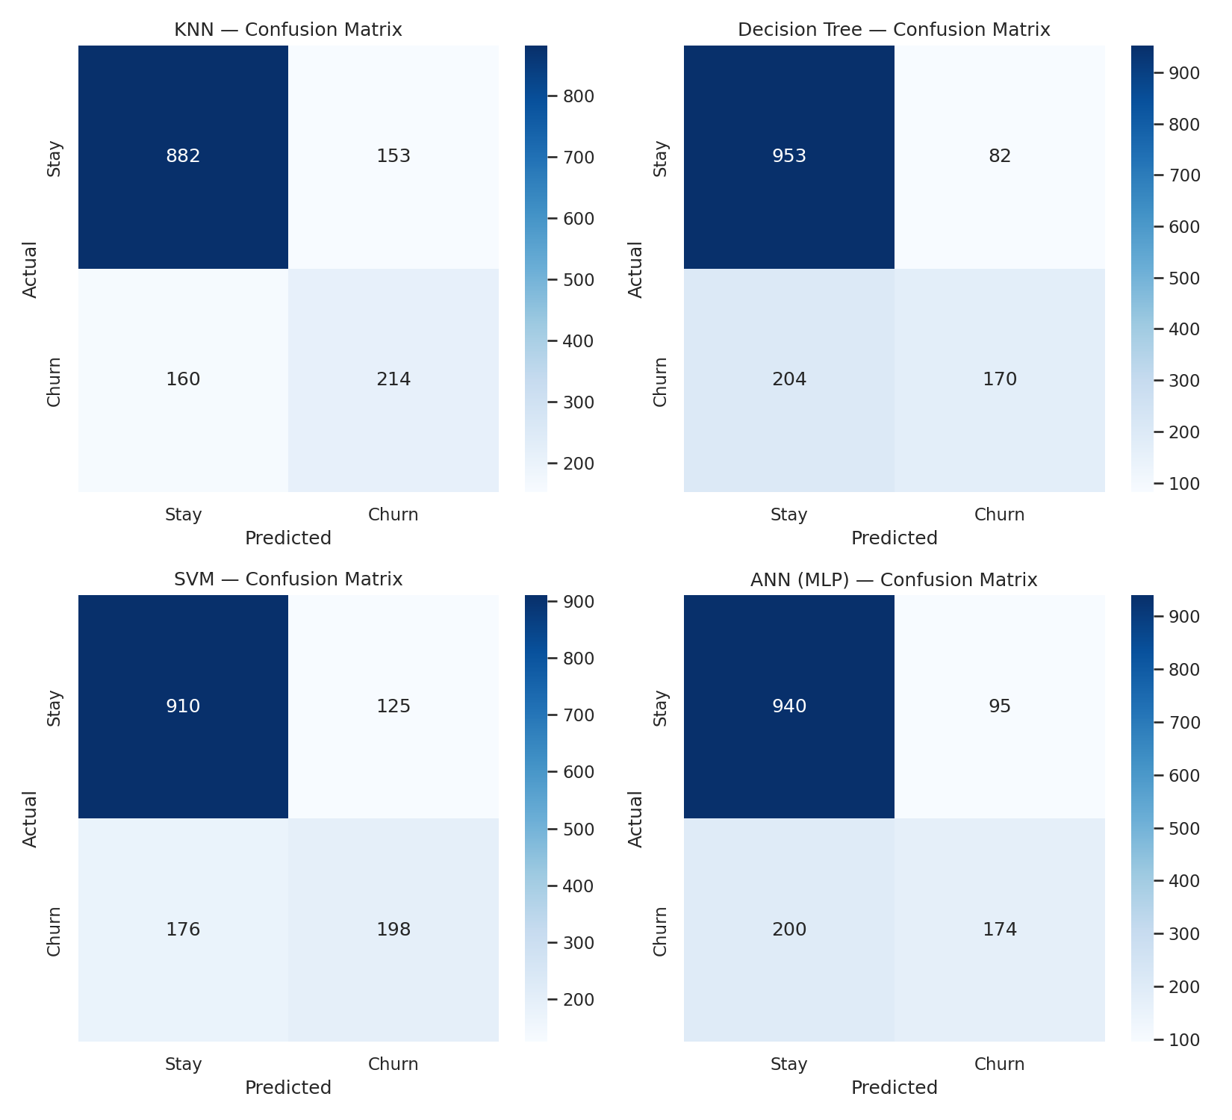
RESULTS
Where Each Model Gets It Wrong
11
KNN missed 162 churners · Tree 167 · SVM 176 · ANN 177 false negatives (missed churners), out of 1,409 test customers.

Slide 14
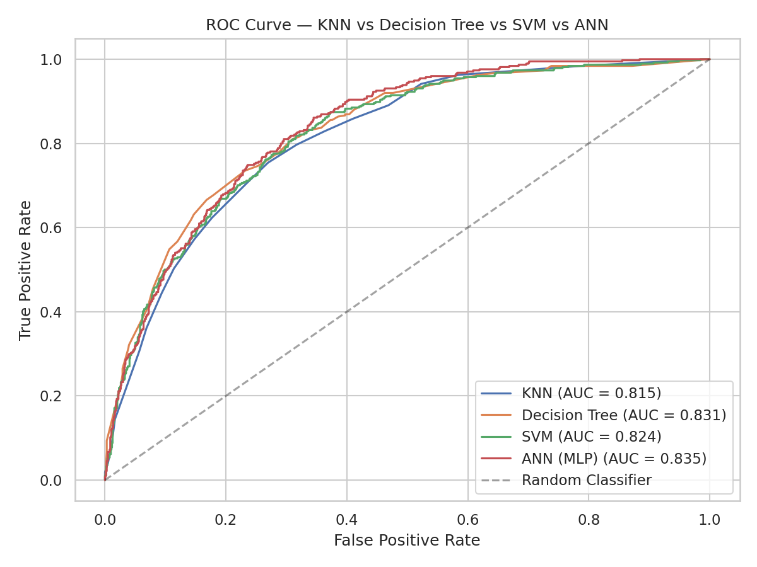
RESULTS
Separating Signal from Noise
The ROC curve shows how well each model distinguishes churners from stayers across every possible decision threshold — not just the default 50% cutoff. The closer to the top-left corner, the better.
ANN: AUC = 0.839
SVM: AUC = 0.826
All four models comfortably beat the diagonal “random guess” line (KNN 0.820, Tree 0.819)
12

Slide 15
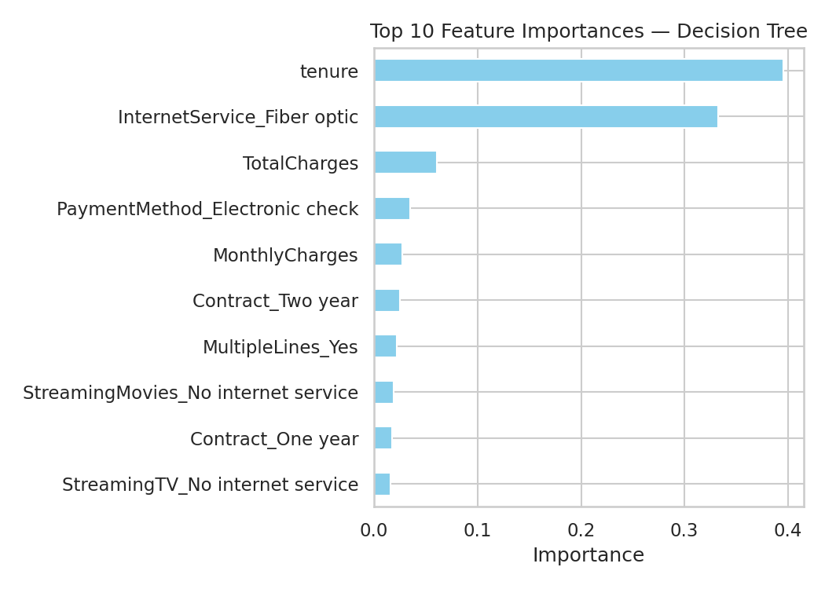
INSIGHTS
What Actually Drives Churn
Tenure is king
New customers (low tenure) are far more likely to churn than long-time ones.
Fiber optic internet
Surprisingly the 2nd strongest signal — possibly pricing or service quality issues.
Charges matter less
Total and monthly charges contribute, but far behind tenure and service type.
13

Slide 16

PRIOR WORK
How this project compares to published churn studies
IBM Telco baseline studies
KNN, Tree & SVM studies
Neural network (ANN) studies
Most published work on this same IBM Telco dataset reports 77-80% accuracy with logistic regression or decision trees before balancing — in line with our 78-79% baseline.
Prior telecom studies report Decision Trees beating other classifiers by 3-6% accuracy, and kernel SVMs reaching 81-92% depending on preprocessing — our tuned SVM (78.9%) sits at the modest end of that range, since we skipped resampling.
Published ANN churn models report 79-90% accuracy depending on architecture and data balancing. Our single-hidden-layer MLP (79.2% accuracy, best ROC AUC at 0.839) fits comfortably within that range.
Sources: IBM/Kaggle Telco dataset studies; telecom ML surveys on KNN, Decision Tree, SVM & ANN churn models (2019-2026)

Slide 17
REGIONAL RELEVANCE
Why this matters for Kenya & East Africa
Churn is a live problem here
The same pipeline applies directly
Africa-wide opportunity
Kenyan telecom operators see churn rates from roughly 5% up to 31.5%. With Safaricom’s tens of millions of subscribers, even small improvements in early detection translate into major revenue protected.
Kenyan researchers have already applied machine learning and uplift modelling to Safaricom subscriber data. The cleaning, scaling & tuning steps in this project transfer directly to prepaid or M-PESA-linked usage data from any East African operator.
Mobile penetration is still rising across Sub-Saharan Africa, and competition between operators is intense. Low-cost, interpretable models like KNN and Decision Trees are well suited to markets where compute budgets and connectivity are limited.
Sources: KCA University repository (Safaricom churn study); published research on telecom churn causes in Kenya

Slide 18
CONCLUSION
All four models beat guessing — the right choice depends on the goal
Missing a churner is costly
ANN wins on power, Tree on clarity
Retention should target tenure
In most businesses, a false negative (losing a customer you never flagged) costs more than a false alarm. That favors KNN's higher recall (56.7%).
The neural net leads on accuracy and ROC AUC, but a Decision Tree's rules can be read directly by a retention team — no black box, easy to act on.
Since new customers churn most, focus retention efforts on the first few months of the relationship.
Built with Python, scikit-learn, pandas & the Telco Customer Churn dataset

Slide 19
REFERENCES
Sources cited in this project
IBM / BlastChar. Telco Customer Churn Dataset [IBM Sample Data Sets]. Kaggle. kaggle.com/datasets/blastchar/telco-customer-churn
Vafeiadis, T., Diamantaras, K.I., Sarigiannidis, G., & Chatzisavvas, K.Ch. (2015). A comparison of machine learning techniques for customer churn prediction. Simulation Modelling Practice and Theory, 55, 1-9.
Amin, A., Al-Obeidat, F., Shah, B., Adnan, A., Loo, J., & Anwar, S. (2019). Customer churn prediction in telecommunication industry using data certainty. Journal of Business Research, 94, 290-301.
Lalwani, P., Mishra, M.K., Chadha, J.S., & Sethi, P. (2021). Customer churn prediction system: a machine learning approach. Computing.
Ochieng, A.C. (2021). Uplifting Model for Predicting Subscriber Churn Conversion Using Ensemble Learning: A Case Study of Mobile Telecommunication Sector in Kenya. MSc Dissertation, KCA University. repository.kcau.ac.ke

